Slide 1
VBA Training – Part IV

Slide 2
Chart using VBA
Add a Chart
Embedded Charts
Dim co As ChartObject
Dim ch As Chart
Set co = Worksheets(“Sheet1”).ChartObjects.Add(50, 50, 250, 165)
Set ch = co.Chart
Chart Sheets
Dim ch As Chart
Set ch = ActiveWorkbook.Charts.Add
Identifying Data to Be Plotted
SetSourceData(Source, PlotBy)
ch.SetSourceData Source:=Worksheets(“Sheet1”).Range(“B3:F6”) . PlotBy:=xlRows
Specifying Chart Type
ch.ChartType = xlLineMarkers
(Chart Types : xlBar xlLine xlArea xlPie xlColumn xlPyramid )
Displaying Chart Titles
HasTitle. A True/False value specifying whether the title is displayed. (ch.HasTitle = True)
ChartTitle. A ChartTitle object that controls the details of the title. (ch.ChartTitle.Text = “Annual Sales”)
Properties of the ChartTitle Object
AutoScaleFont: True/False value specifying whether the title’s font size changes automatically when the chart size is changed. The default is True.
HorizontalAlignment: Specifies the left-right alignment of the title. Set to xlLeft,xlCenter (the default), or xlRight.
Left: The distance in points from the left edge of the title to the left edge of the chart area.
Top: The distance in points from the top edge of the title to the topedge of the chart area
Text: The text of the title. By default this is blank.

Slide 3
User Forms
Working with Fonts in a Chart
The chart title Chart.ChartTitle.Font
The category axis title Chart.Axes(xlCategory).AxisTitle.Font
The value axis title Chart.Axes(xlValue).AxisTitle.Font
The legend text Chart.Legend.Font
The category axis tick mark labels Chart.Axes(xlCategory).TickLabels.Font
The value axis tick mark labels Chart.Axes(xlValue).TickLabels.Font
ChartObject Properties
BottomRightCell Returns a Range object referencing the single worksheet cell under the lower right corner of the chart. Read-only.
Chart Returns a reference to the contained chart.
Height The height of the chart in points.
Left The position of the left side of the chart with respect to the left edge of the worksheet; in points.
Placement Specifies how the ChartObject is attached to the worksheet cell under it. Permitted settings are xlMoveAndSize, xlMove, and xlFreeFloating.
PrintObject If True (the default), the chart is printed when the worksheet is printed. If False, the chart is not printed.
Top The position of the top the chart with respect to the top of the worksheet; in points.
TopLeftCell Returns a Range object referencing the single worksheet cell under the top left corner of the chart. Read-only.
Visible True/False value specifying if the chart is visible.
Width The width of the chart; in points.
Copy Copies the ChartObject to the Windows Clipboard.
CopyPicture Copies an image of the chart to the Windows Clipboard.
Delete Deletes the ChartObject.

Slide 4
Chart using VBA
Every chart series has a formula which describes the data in the series. For example, a simple series formula looks like this:
=SERIES(Sheet1!$B$1,Sheet1!$A$2:$A$11,Sheet1!$B$2:$B$11,1)
This formula can be broken up into four elements as follows:
=SERIES([Series Name],[X Values],[Y Values],[Plot Order])
The Series Name can be blank, a text string in double quotation marks, a reference to a worksheet range (one or more cells), or a reference to a named range (named formula).
The X Values can be blank, a literal array of numeric values or text labels enclosed in curly braces, a reference to a worksheet range (one or more cells), or a reference to a named range (named formula).
The Y Values can be a literal array of numeric values enclosed in curly braces, a reference to a worksheet range (one or more cells), or a reference to a named range (named formula).
The Plot Order can only be a whole number between 1 and the number of series in the chart.
Manually set the values for the data series
ActiveChart.SeriesCollection(1).Formula = "=SERIES(""First Data"",{""a"",""b"",""c"",""d""},{2,3,4,5},1)" ActiveChart.SeriesCollection(2).Formula = "=SERIES(""Second Data"",{""a"",""b"",""c"",""d""},{6,7,8,9},2)"
ActiveChart.SeriesCollection(3).Formula = "=SERIES(""Third Data"",{""a"",""b"",""c"",""d""},{10,11,12,13},3)"

Slide 5
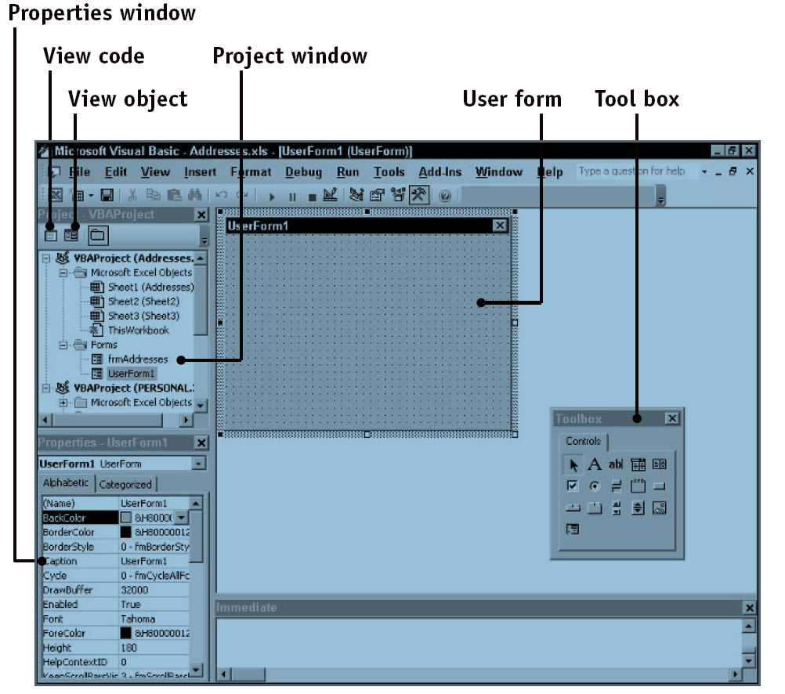
User Forms
The form or userForm is also known as a GUI (Graphical User Interface).
The form is used to require values, parameters and information from the user to feed the VBA procedure.

Slide 6
User Forms
Displaying, Using, and Hiding Forms
1. Create an instance of the user form, at the same time declaring a variable that references the form.
Dim frm As New MyUserForm
2. If necessary, use the form reference to set values of properties for the form and its controls.
frm.Backcolor = RGB(210, 210, 210)
frm.TextBox1.Value = “Some text”
3. Display the form to the user.
frm.Show
4. At this point the user interacts with the form by entering data, selecting options,and performing other actions for which the form was designed.
5. When finished, the user takes some action to close the form, typically by clicking a button on the form. Code in the form executes the Hide method to hide the form.
Me.Hide
6. Code in your program can now retrieve information from the form’s controls as needed.
Response = frm.TextBox1.Value
7. Unless you want to use the form again, destroy it by setting its reference to Nothing in order to free up the memory that the form used.
Set frm = Nothing

Slide 7
User Forms
Controls for User Forms
CheckBox Displays an option that can be turned on or off
ComboBox Combines the function of a TextBox and a ListBox
CommandButton Displays a button that is selected by the user to carry out some action
Frame Used to group other controls, such as OptionButtons
Image* Displays an image
Label Displays text that cannot be edited by the user
ListBox Displays a list of items from which the user can select
TextBox Displays text that the user can edit
OptionButton Similar to a CheckBox, but only one OptionButton in a group can be selected at one time. To create a group of OptionButton controls, place a Frame control on the user form; then draw the OptionButton controls on the frame.
Common Control Properties
BackColor An RGB value specifying the control’s background color
ControlTipText The text that is displayed when the user hovers the mouse cursor over the control; blank by default.
Enabled If True, the control is enabled, and the user can interact with it. If False, the control is visible but “grayed out,” and the user cannot interact with it.
Font A Font object controlling the font used to display text in the control.
ForeColor An RGB value specifying the control’s foreground color
Locked If True, the control cannot be edited or changed. The default is False.
Visible True to display the control; False to hide it.

Slide 8
User Forms
Label controls
Label controls are mainly used to describe other controls on a UserForm.
A Label control cannot be edited by the user while the UserForm is running.
Use the Caption property to set or to return the text in a Label control.
The ComboBox Control
It displays a list of text items from which the user can select as well as an editing box for exiting or entering data.
Style Property : A ComboBox can operate in one of two modes, controlled by its Style property
frmStyleDropDownCombo The user can select an item from the list or type a value in the edit region. This is the default style.
frmStyleDropDownList The user is restricted to selecting an item from the list.
Items are added to a ComboBox using its AddItem method. The syntax is: ComboBox.AddItem Item
Each item you add to a ComboBox is assigned a numerical index.
The first item added has index equal to 0, the second item has index equal to 1, and so on.
When the user selects an item in the ComboBox or enters text in the edit area, the control’s Value property returns
the text (or an empty string if no item is selected).
The value returned by the ListIndex property is as follows:
If the user has selected an item in the ComboBox’s list, the item’s index number is returned.
If the user has not selected and item or has entered text in the edit area, -1 is returned.

Slide 9
User Forms
The Frame Control
The Frame control is used to group other controls; it has no functionality of its own, although it can detect Click events.
A Frame control displays as a rectangular bordered box with a caption.
After placing a Frame control on a form, you can place other controls on it.This provides the following capabilities:
If you move the Frame control (either while designing the form or in code), the contained controls move along with it.
If you set the Visible property of the Frame control to False, all of its contained controls are hidden as well.
The OptionButton Control
The OptionButton is similar to a CheckBox control in that it permits the display and selection of a True/False, yes/no option.
A group of OptionButtons can be defined by placing them all within a Frame control.
Another way to define a group of OptionButtons is by means of the GroupName property.All OptionButton controls with the same GroupName are considered to be part of a group,and are mutually exclusive even if they are not together in a Frame control.
To determine which OptionButton in a group is selected, your code must go through all the OptionButton controls looking for one whose Value property is True.
The TextBox Control
It can display text to the user for editing and can also be displayed as blank to permit the user to enter data.
If you want to display more than one line of text in a TextBox control, set its MultiLine property to True.
EnterKeyBehavior If False (the default), pressing Enter moves the focus to the next control and the user must press Shift+Enter to start a new line in the text box. If True, pressing Enter starts a new line.
MaxLength The maximum number of characters that the text box can hold. If 0 (the default), there is no limit.
Password Char Specifies the placeholder character used to display text in the text box. For example, set this property to “*” to display all asterisks. Used for password entry to prevent accidental viewing of the password by an unauthorized person.

Slide 10
TabKeyBehavior If True, pressing Tab inserts a tab into the text (but only if the MutliLine property is also True). If False (the default), pressing Tab moves the focus to the next control.
TextLength Returns the number of characters in the text box.
The CommandButton Control
The CommandButton control displays a button on a form. The main use for this control is to carry out some action when the user clicks the button.
To perform an action, put the required code in the Click event procedure for the control.
The CheckBox Control
The CheckBox control provides an option or setting that the user can turn on or off by clicking.
It consists of a small box with an adjacent label. When on, the box displays a check mark; when off, the box is empty.
The Caption property determines the label displayed next to the box.
The Value property returns True if the box is checked, False if not.

